Slide 1

CivicsPolitical Capstone
Introduction
Main Question
Purpose
Data Source
Database
Visualization
Tools
Aida, Joseph, Liza, and Irina

Slide 2
MAIN QUESTION
Are social and demographic characteristics determinative of voting for Trump?

Slide 3
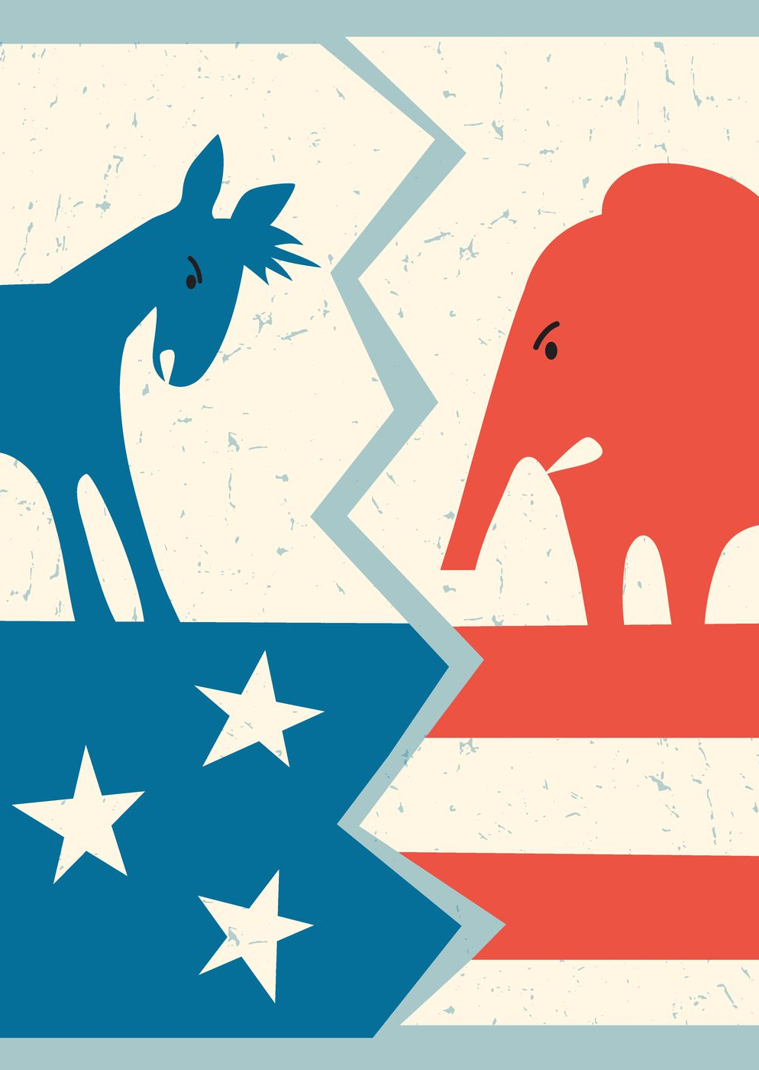
WHY?
Introduction
Main Question
Purpose
Data Source
Database
Visualization
Tools
In a politically polarized American society, understanding underlying drivers for political decisions may reduce existing tensions and contribute to a more balanced and cooperative political culture.
Notes:
We selected this topic because in a politically polarized society, understanding underlying drivers for political decisions may be useful in bringing about a more balanced and cooperative political culture.

Slide 4
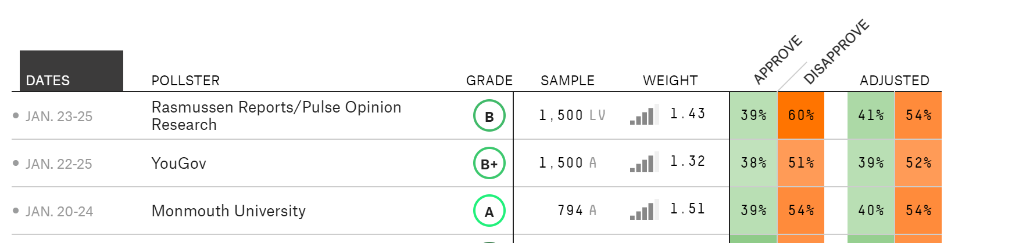
DATA SOURCE
Introduction
Main Question
Purpose
Data Source
Database
Visualization
Tools
Cooperative Congressional Election Study (CCES)
Dataframe (452,755 observations, 73 features)
Geographic, demographic, economic, news interest, political affinity, and presidential choice variables
One of the most comprehensive political surveys in the US
Notes:
Kuriwaki, Shiro complied voter survey data in .Rds file format for the years 2006–2018. The dataframe contains 452,755 rows (observations) and 73 columns (features), including geographic, demographic, economic, news interest, political affinity, and presidential choice variables.
The data was drawn from Cooperative Congressional Election Study (CCES), one of the most comprehensive political surveys in the US.

Slide 5


Slide 6
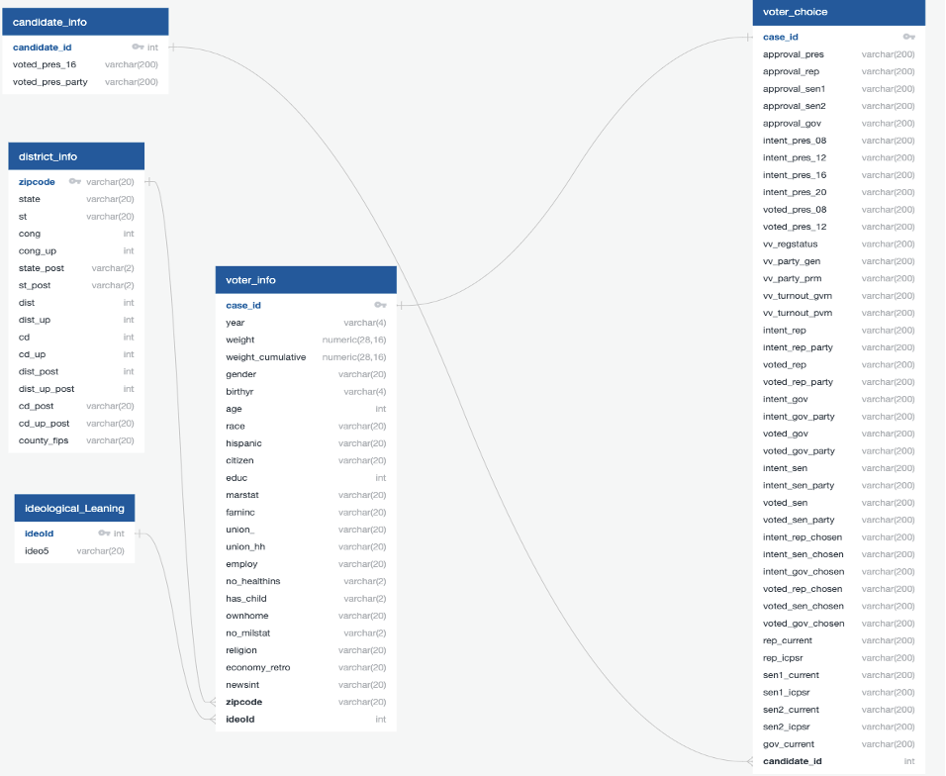
DATABASE
Introduction
Main Question
Purpose
Data Source
Database
Visualization
Tools
Notes:
The data set is divided into 5 CSV files and from each of them has been created a separate table in Postgres DB:
candidate_info, district_info, ideological_leaning, voter_info, voter_choice

Slide 7
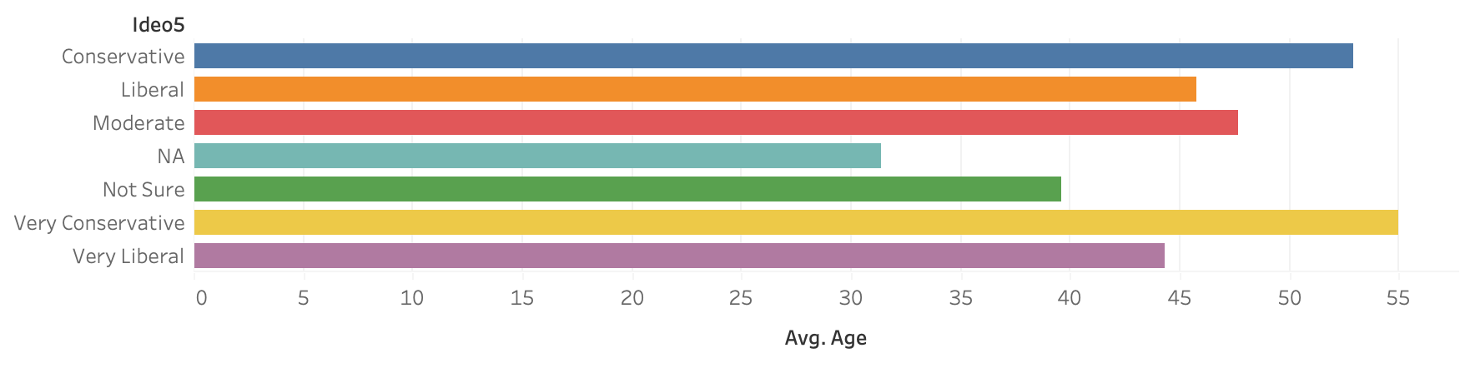
Visualization
Introduction
Main Question
Purpose
Data Source
Database
Visualization
Tools
Notes:
This figure shows the average age of people voting for each ideology. We can see that the average age of Very Conservative and Conservative voters is 55 and 53, respectively, which also seem to be the older people from our dataset. We can also observe that the younger people are, the more likely they are to be Not Sure regarding their ideology, Liberal, and Very Liberal. The average age of Moderate voters falls, as expected, between the average of Liberal and Conservative voters.

Slide 8
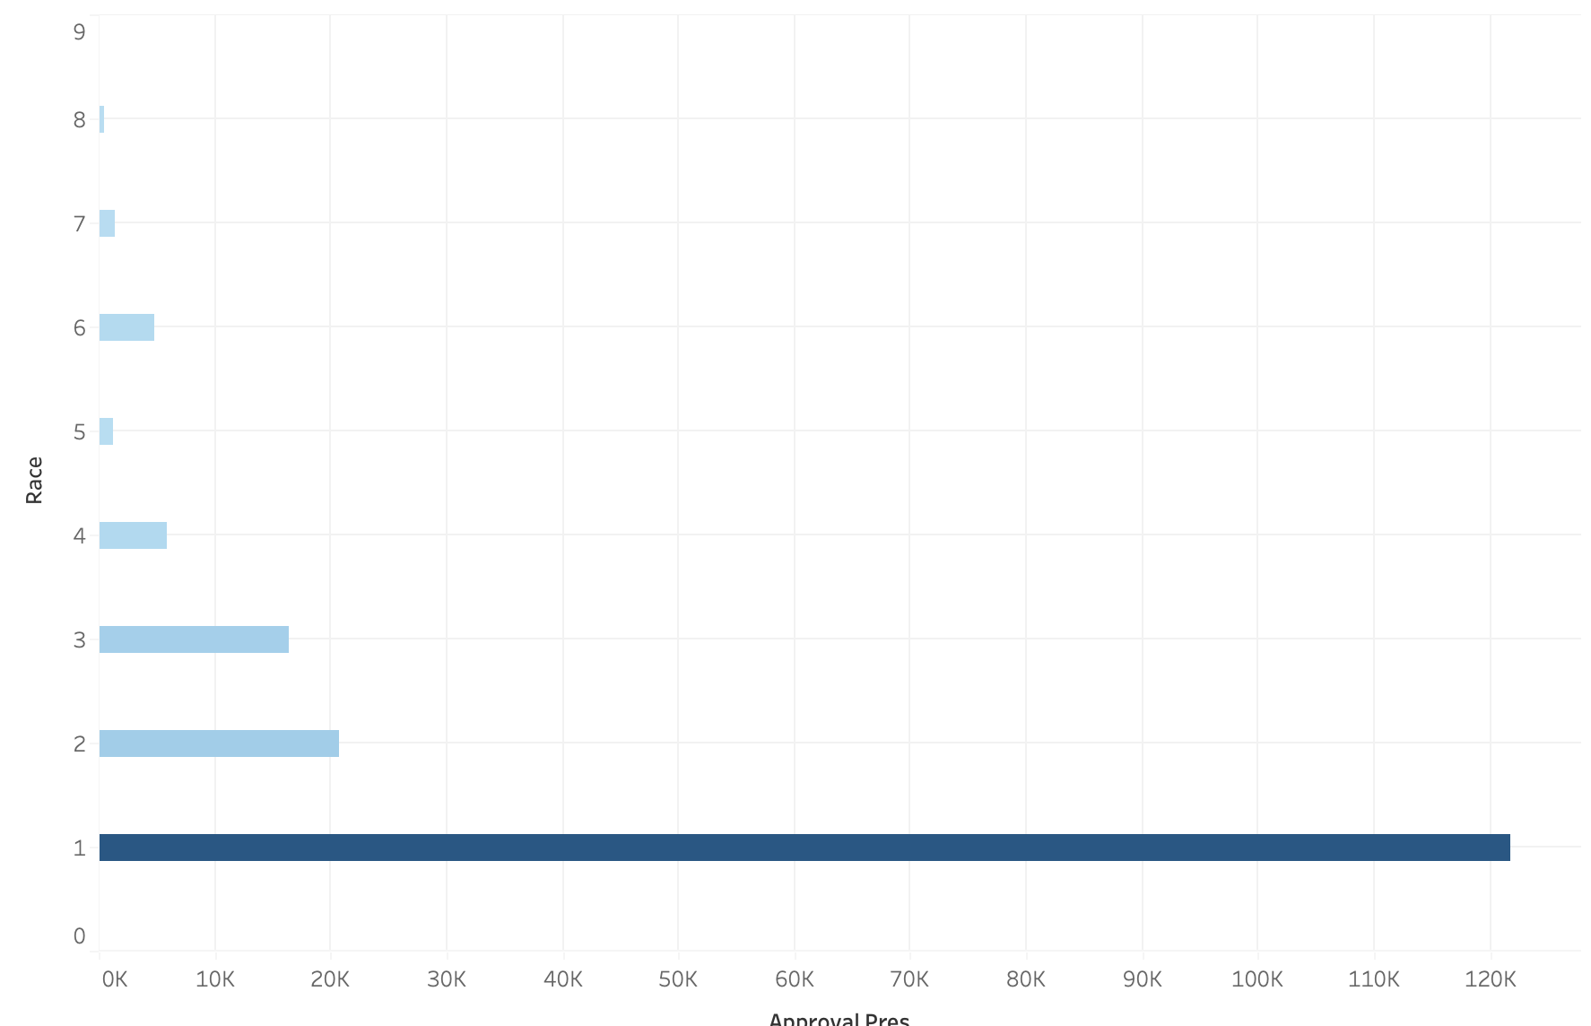
Visualization
Introduction
Main Question
Purpose
Data Source
Database
Visualization
Tools
Notes:
In this image, we can see the approval of the president based on each race.

Slide 9
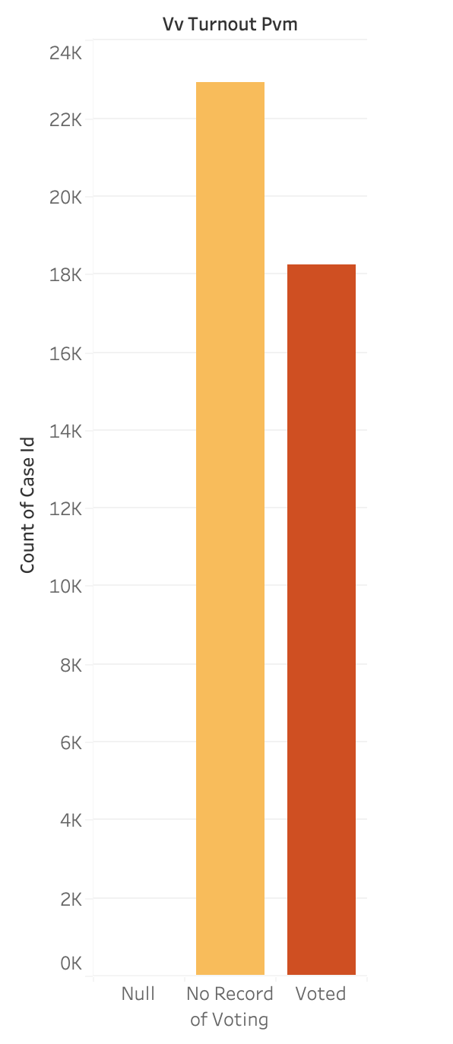
Visualization
Introduction
Main Question
Purpose
Data Source
Database
Visualization
Tools

Slide 10
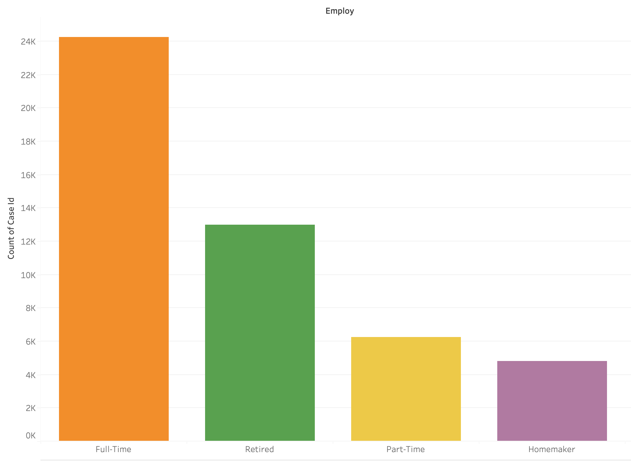
Visualization
Introduction
Main Question
Purpose
Data Source
Database
Visualization
Tools
Notes:
Looking at the employment status of voters, we can see that the people that voted the most were full-time employees and retired people. Part-time workers and homemakers ranked third and fourth, respectively. It is interesting to note that students and unemployed people have very low voting rates. This indicates that future analysis might be done to determine why certain demographics have lower voting turnout.

Slide 11




TOOLS - Technologies, Languages, and Algorithms Used
Github
Python
Jupyter Notebook
Machine Learning
Lots of coffee
Introduction
Main Question
Purpose
Data Source
Database
Visualization
Tools
Tableau
Storage and display
Analysis
Visualization
Workbook and Analysis
Energy
Keras

Slide 12
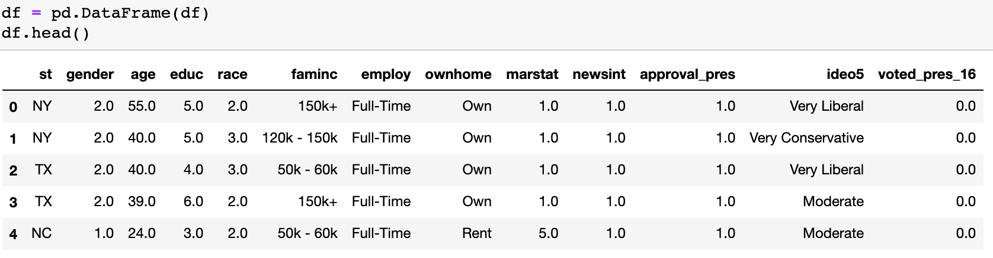
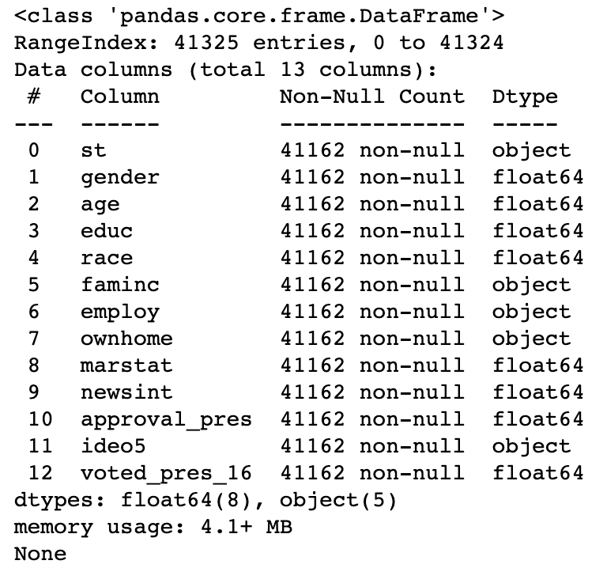
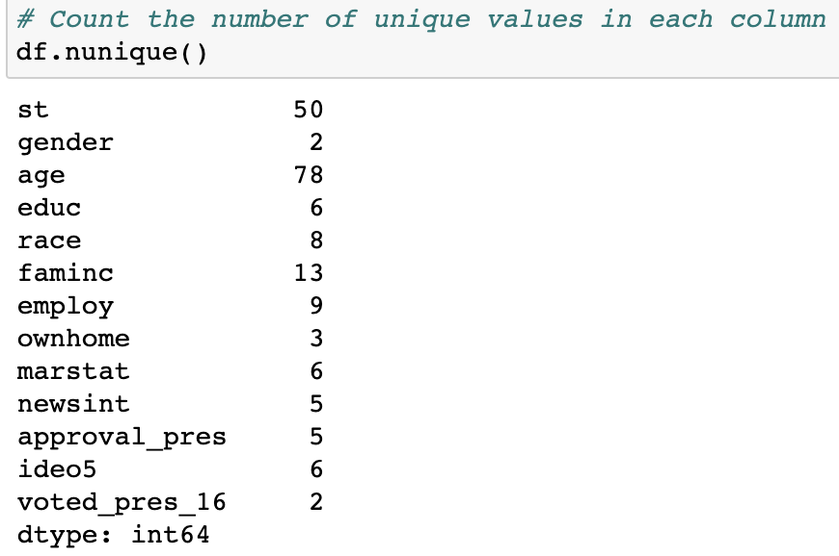
METHODOLOGY - Data Exploration
Refined the election survey database for the year 2018, and filter out selected features into a dataframe
Information on the columns and dtypes
Notes:
The database did not contain a uniform data type so many of the features that are chosen for the analysis are categorical. We have opted to use a simple neural network to predict voter outcome, but before that some data preprocessing was needed to make the training and test data sets to feed into the machine learning model. Some features contained a significant number of unique values compared to others. To take on this issue we used pandas get dummies function since it turns string columns into multiple numeric value columns. With the features ready they were then split into input features and the target array. A StandardScaler instance was created to transform the data to have its distribution and standard deviation more uniform.

Slide 13
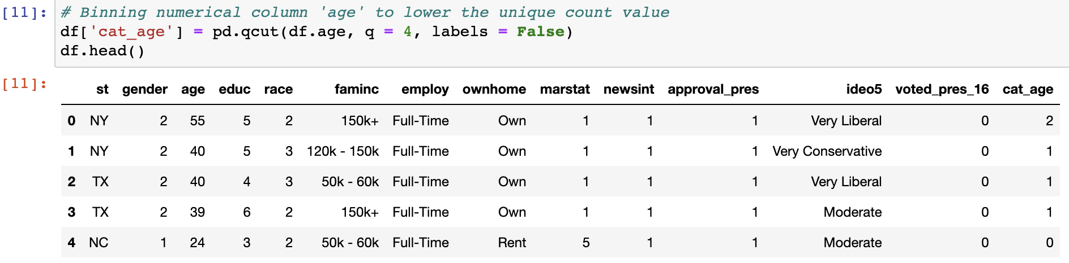
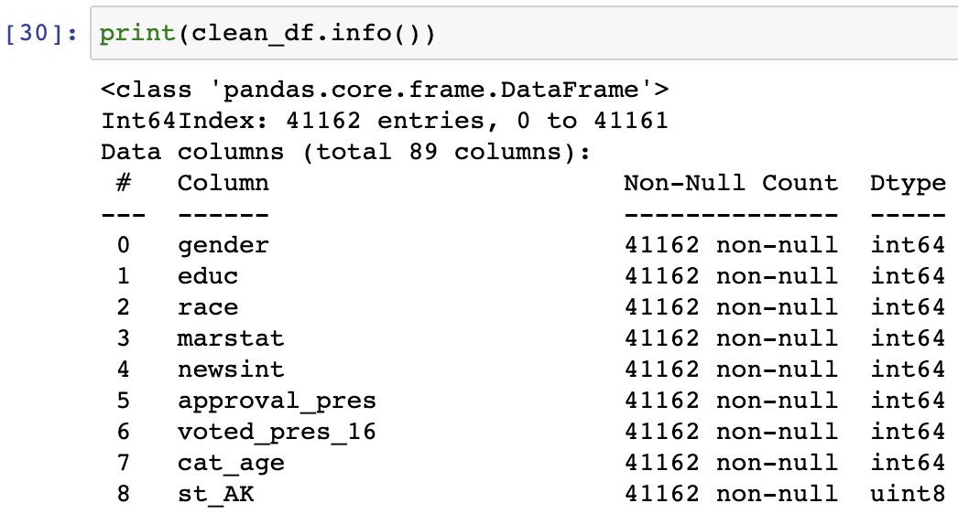
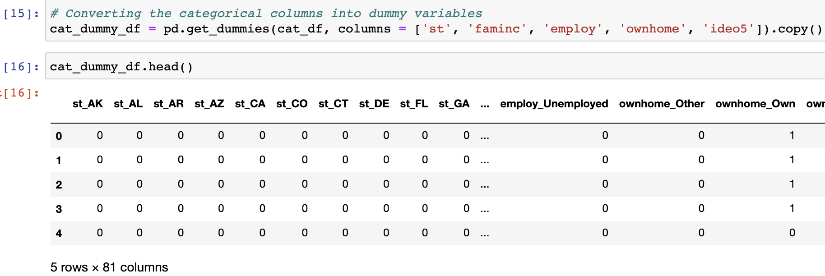
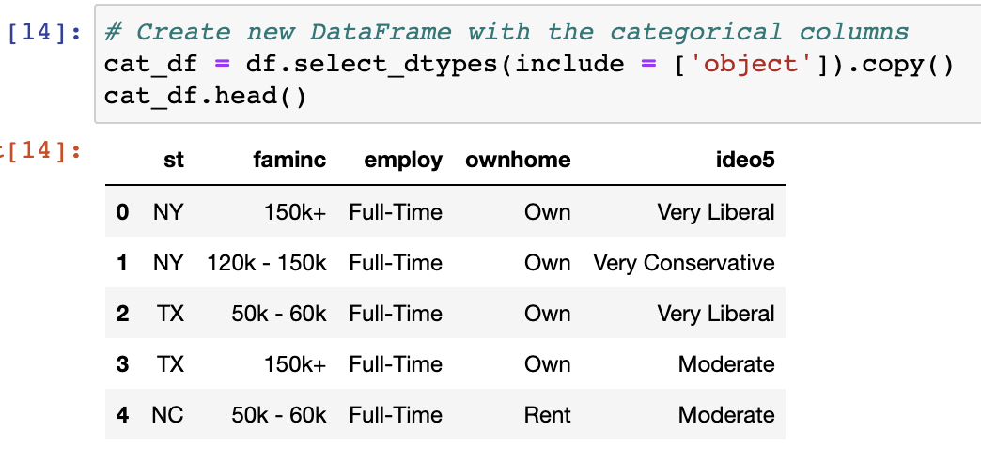
METHODOLOGY - Data Exploration
Preprocess categorical features for machine learning
Dataframe information after encoding categorical features via binning and dummy columns, then dropping original categorical columns

Slide 14
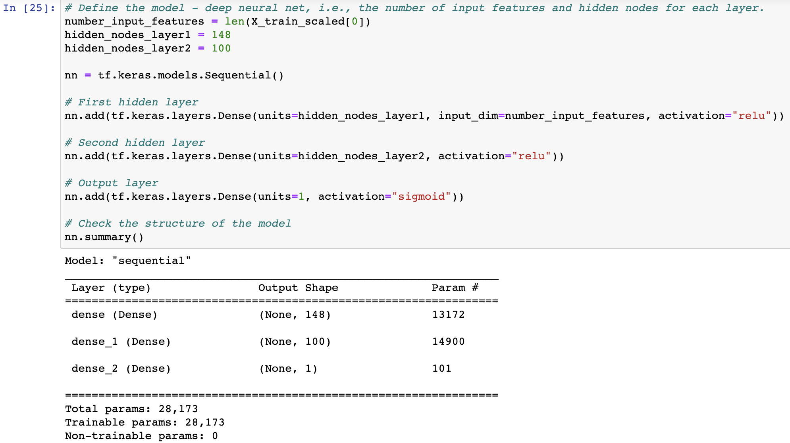
Neural Network Analysis
Keras sequential model used due to its streamlined design and minimal user action
Two hidden layers with ReLu activation function, the features have a non-linear relationship
Output column uses sigmoid activation function for the binary classification of whether someone votes one president over another
Notes:
This type of analysis gears towards a classification model, we used the Keras sequential model. This model is used for the task because of its simplicity to design a neural network and minimal user action. The input layer will contain the features that have been used to train the model. To get a better accuracy we will use two hidden layers with activation function Relu (Rectified Linear Unit). ReLu is used due to its simplicity compared to other activation functions, it also takes into account the non-linear relationship between the features selected. To follow suit with another neural analysis that inspired this analysis the first hidden layer will have 148 neurons and the second hidden layer will have 100 neurons. The output layer used was the sigmoid activation function we are trying to predict whether a voter chose one president over another.
The defined model is now compiled with the following parameters: Optimizer parameter is adam, used due to the volume of data rows within each feature. Loss parameter is sparse_categorical_crossentropy because this is a binary classification model after the preprocessing stage. The model is then trained, traditionally neural networks have a high number of epochs, for this analysis we chose 500 epochs to see if we can get a higher accuracy score. Afterwards the model is evaluated, and the loss percentage was 2.22 with an accuracy of 90.4%

Slide 15
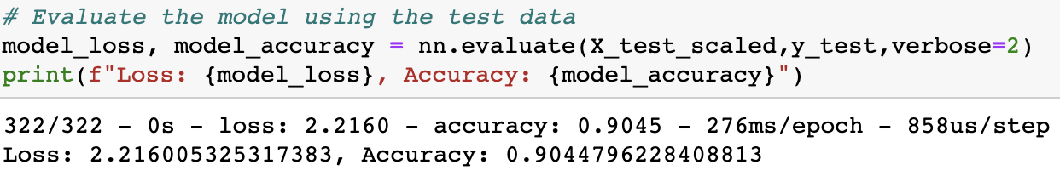
METHODOLOGY - Data Exploration
Notes:
With this return value the model does a fairly good job of predicting voter preference. This is taking into regards that the outcome column “voted_pres_16” was manipulated into unique values if the surveyor voted for one president or other. Originally the database contained many categorical answers which would make fitting into the machine learning model more difficult. This is a simple model compared to what organizations in the political sphere and thinktanks would use for voter prediction.

